Slide 1
Warehouse Management System for Small Business
Yudu Du, Yihan Xu, Ming Du, Chunhui Xu
Two D, Two X, then team 2DX

Slide 2
Introduction
warehouse management is a key part of the supply chain and primarily aims to control the movement and storage of materials.
warehouse management data base system could help people monitor the progress of products through the warehouse.
it could provide a set of computerized procedures for management of warehouse inventory, space, equipment and people with the goal of minimizing cost and fulfillment times.

Slide 3
Client Information
As for China, even though there are a lots of smaller factories have capacity to accept the huge orders of light industry products, ineffective manual management caused in poor profits. Based on this, some smaller factories/companies are trying to find some advanced management method, and the systematic warehouse database is a really useful tool for them.

Slide 4
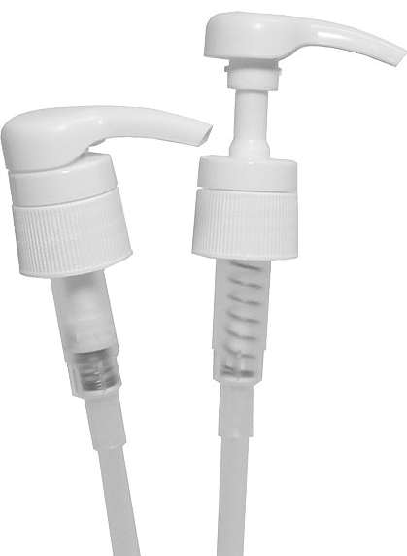
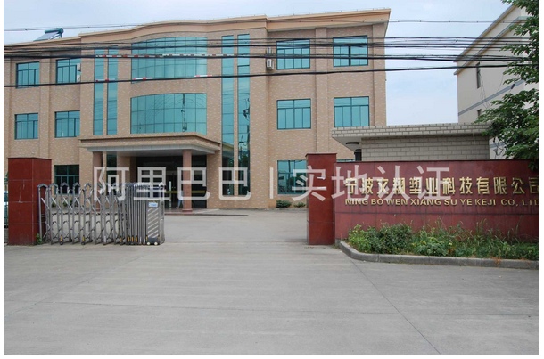
Client Information
Our target client is a smaller plastics company, Ningbo Wenxiang Plastic Technology Company, which is located in Ningbo, China. This company specialized in processing plastic lotion pump.

Slide 5
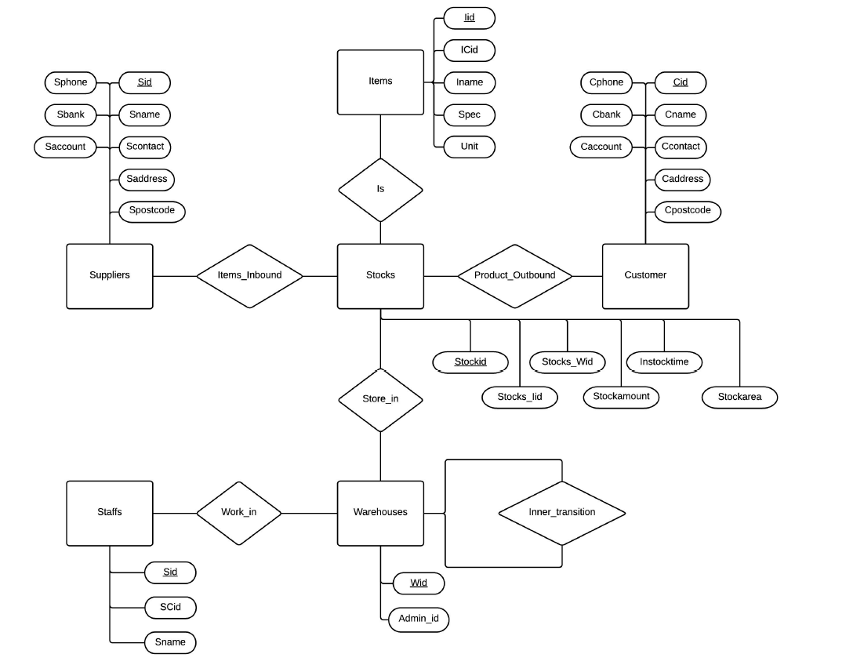
E-R Diagram
In this warehouse storage scenario, we defined 6 basic entities: supplier, item, stocks, warehouse, customer, and staff

Slide 6
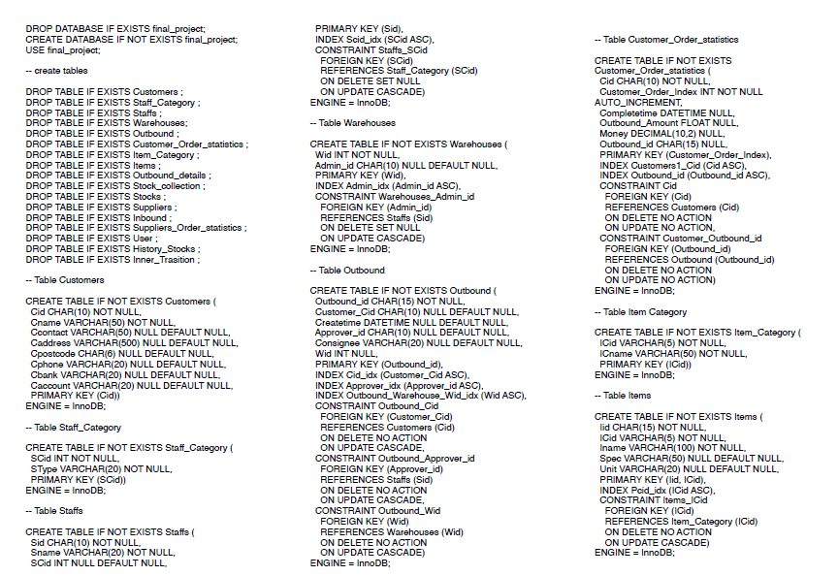
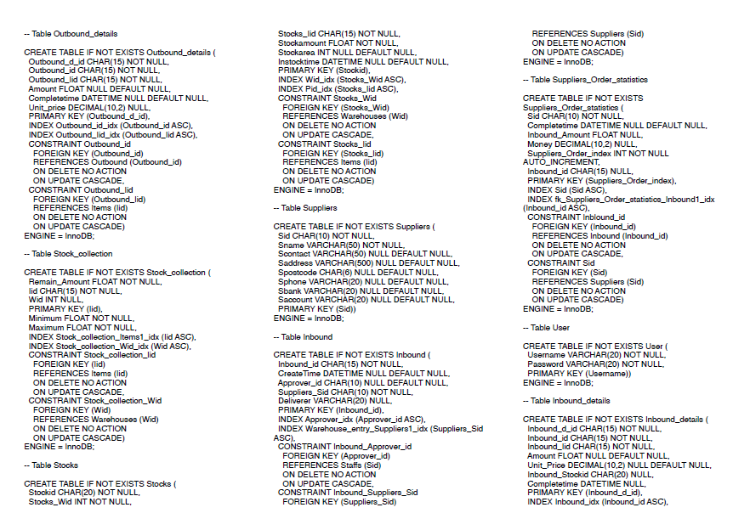
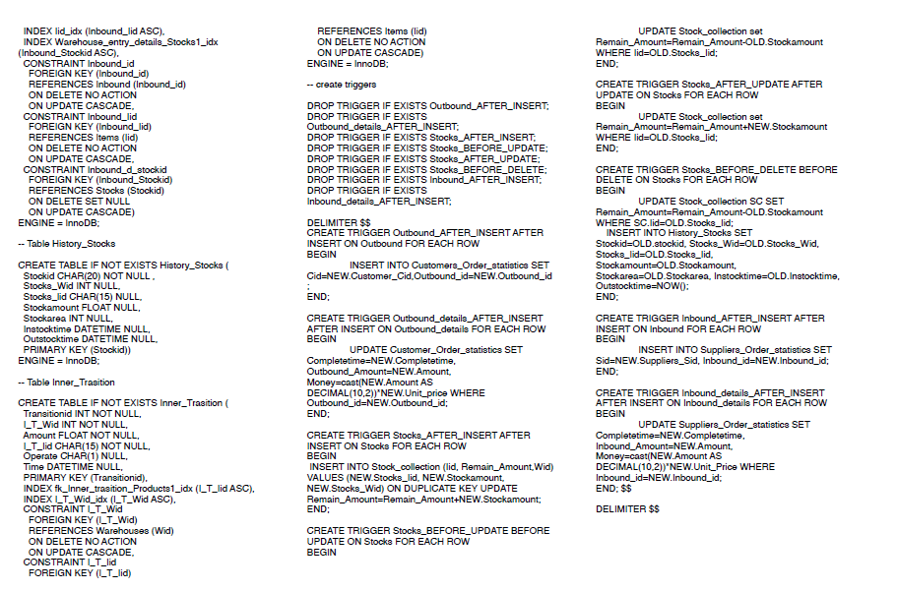
SQL Statements
No one wants to see the code.. But we provide

Slide 7
System: Basic Information
http://babbage.cs.missouri.edu/~cs4380sp15grp12/?/dashboard/add
A web-based design
Primarily, the 语言 is used to develop the system.

Slide 8
System: Queries
List the amount and id of products purchased by a certain client in a certain period
Who is our major clients? Maybe we could give discounts to them..
List the ID of material in inventory whose current amount is lower than safe value.
We don’t want to our factory stop work because of shortage of any materials.
Check the identity information of the warehouse-keeper who created the inbound record of a certain batch of goods.
If some goods have problem, we want to trace back to someone who should be inquired.

Slide 9
System: Analysis

Slide 10
System: Index

